Slide 1
STARTUP INDIA and the growth of the tourism startup ecosystem
Notes:
The recently released International Monetary Fund forecast maintains that India shall remain as the fastest growing economy in the world despite global slowdown.
And indeed, it is a matter of pride for us to talk about the story of India's journey through the past, present, and future.
In a very short span of time, India has shown a great appetite for technology, data, and the internet.
The internet paved the way for thousands of startups to rise over the past decade, address unique problems, transform entire industries, and create new segments.
These startups are contributing economically, creating wealth, and generating employment through the length and breadth of the country.
This is Pratiti from Startup India and today let us all look at behind-the-scenes of this ecosystem which is fueled by innovation, passion, and entrepreneurial spirit.

Slide 2
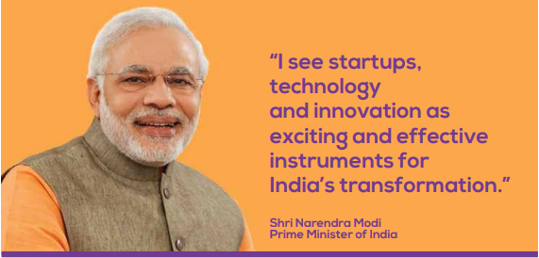
STARTUP INDIA
Action Plan 2016
19 Action Points
16th Jan’16
Simplification & Handholding
Funding Support & Incentives
Industry-academia partnerships & incubation
Notes:
The word startup is a buzzword today, but its roots go back to 2016 when the Hon'ble Prime Minister of India, Shri Narendra Modi, launched the StartupIndia initiative as a clarion call to the innovators, entrepreneurs, and thinkers of the nation to lead from the front and drive India’s sustainable economic growth.
The initiative is as a result of the 19 action pointer Action Plan released in the same year, spanning across three major pillars i,e. 1) Simplification and handholding, 2) Funding support and incentives and 3) Industry-academia partnership and incubation” were announced. Startup India was set up with the aim of bringing this to implementation.

Slide 3
THE JOURNEY SO FAR..
20x
13x
95,000+
2023
108
9x
4,640+
8x
8x
$ 70 bn
32 States
7x
700+
2015
4,200
8
490
$ 8 bn
4 States
100
Startups
Unicorns
Investors
Funding
Policy
Incubators
Notes:
Be it startups and unicorns or the enablers of this ecosystem the incubators and investors have grown exponentially in the past few years (2015-2021):
17X increase in the number of startups
13X increase in unicorns
9X increase in the number of investors
8X increase in the total funding of startups as well number of state startup policies
7X increase in the number of incubators

Slide 4
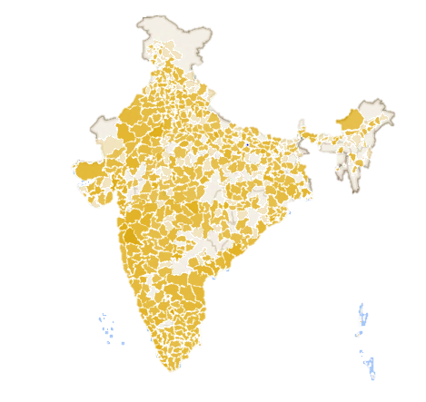
STARTUP ECOSYSTEM IN INDIA
3rd
Largest Startup Ecosystem
95,000+
Total Number of Startups
48%
Startups from Tier-2 & Tier-3 cities
108
STARTUP INDIA RECOGNITION
Unicorns with $340Bn+ Valuation
0
500
3600
978K+
NO. OF STARTUPS RECOGNIZED
Jobs Created
Notes:
These are some quick stats of the startup ecosystem in India. We are the third largest startup ecosystem with 90,000+ recognized startups from all 36 States & UTs in the country.
There has been a 109% yearly increase in jobs created by startups over the last 4 years.
We have 48% of startups from Tier 2 and Tier 3 cities and 47% led by women entrepreneurs.

Slide 5
KEY BENEFITS OF RECOGNITION
Easier Public Procurement Norms
Startup Patent Application & IPR Application
Tax Exemption Under 80IAC
₹10,000 Cr. Fund of Funds for Startups
₹945 Cr. Seed Fund for Startups
Exemption from Angel Tax

Slide 6
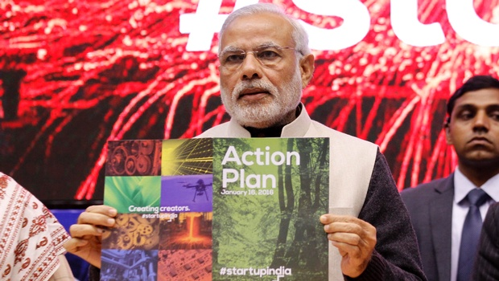
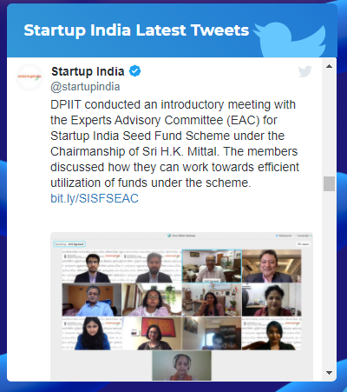
STARTUP INDIA HUB
620 K+
Registered users
254 K+
Avg monthly views
4 mins 02 secs
Avg time spent
25 K+
Connects
www.startupindia.gov.in
Resource Partnered Services
Marquee Programs
Learning & Development Programs
Schemes & Policies
Tools & Templates
Ecosystem Network
Virtual Showcase
Publications & Reports
Notes:
The Government launched a Startup India Online Hub on 19th June 2017 which is one of its kind online platforms for all stakeholders of the entrepreneurial ecosystem in India to discover, connect and engage with each other. The online hub hosts startups, investors, funds, mentors, academic institutions, incubators, accelerators, corporates, Government bodies, and more.
Our one-stop-shop the Startup India Hub has been created to guide and provide for each stakeholder- be it to provide pro-bono services, online entrepreneurial courses, information dissemination, network, or showcase innovation.
All initiatives come to life through the state-of-the-art online presence of Startup India.
You can take note of the link to the website mentioned on the screen.

Slide 7
ACCESS TO FUNDING
DPIIT -> SIDBI-> AIFs -> Startups
Fund of Funds
INR 10,000 crores| Over INR 8,000 crore committed|
103 VCs | 818 startups
Fund focused towards late-stage startups
DPIIT-> Incubators (300) -> ~3,600 Early-Stage Startups
Seed Fund
INR 945 crores (INR 20 lakh Grant |
INR 50 lakh Debt/Convertible Debentures)
Fund focused towards early-stage startups
Notes:
To further boost the ecosystem, the government provides funding support to the startups across the life cycle
Late-stage startups have access to the Startup Fund of Funds with a total corpus of USD 1.26 bn which is provided in form of equity. The fund invests through AIFs registered in India, therefore, providing a push to the enablers of the investment landscape as well.
Seed-stage startups have access to the Startup India Seed Fund Scheme with a corpus of USD 119.4 mn in form of Grant and Debenture.

Slide 8
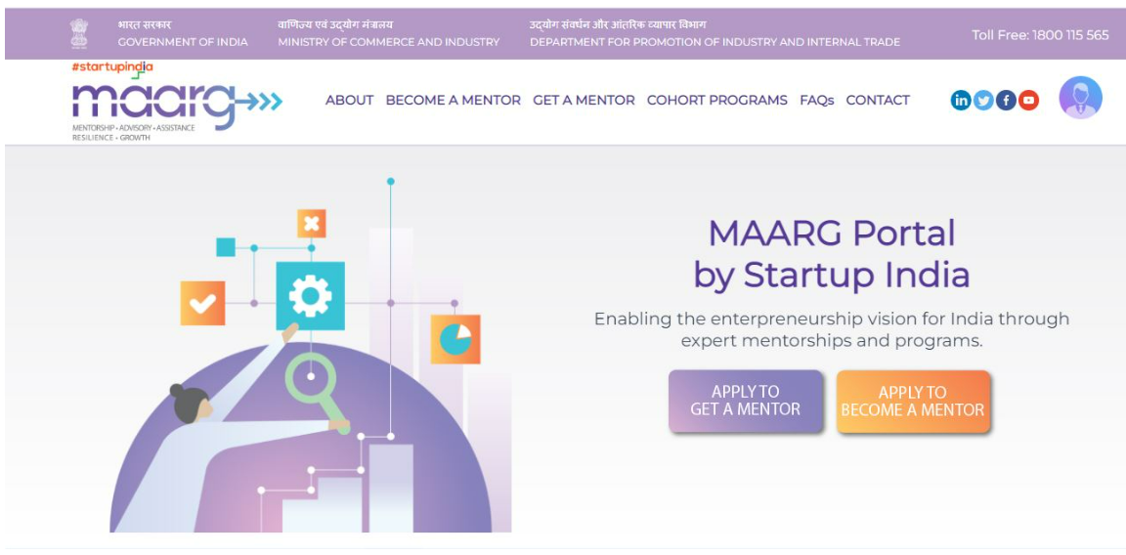
ACCESS TO MENTORSHIP
M
Mentorship
A
Advisory
A
Assistance
R
Resilience
G
Growth
Pro-Bono Mentorship
AI-Based Matchmaking
www.maarg.startupindia.gov.in
Special Incentives for Mentors

Slide 9
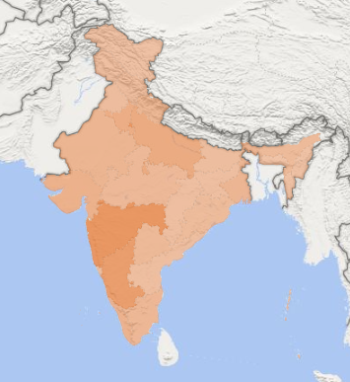
OVERVIEW OF TOURISM SECTOR
STATE-WISE DISTRIBUTION OF STARTUPS
Over 1,400 DPIIT Recognized Startups
Across 32 States and Union Territories
48% Startups from Tier 2 and 3 cities
Top States | No. of Startups
Delhi | 211
Maharashtra | 205
Karnataka | 173
Uttar Pradesh | 109
Haryana | 96
200
100
30

Slide 10
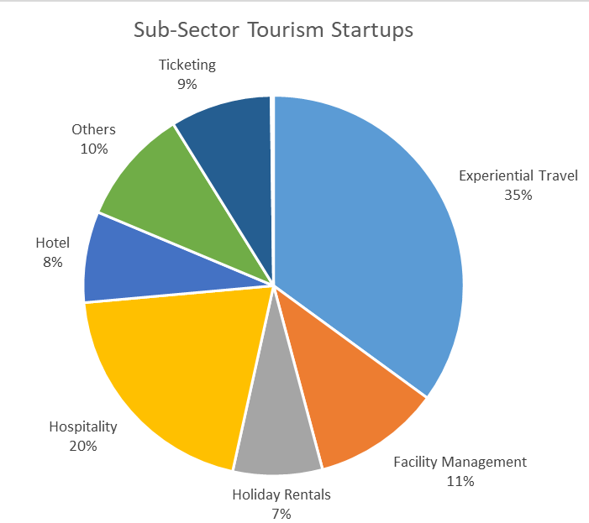
TOURISM SECTOR OVERVIEW
Across 255 districts
Over 50 Startups have availed Startup India benefits
Over 15 incubators
across the country

Slide 11
TOURISM SECTOR OVERVIEW
Param People Infotech has developed a complete road travel support platform called 'Highway Delite' for travelers in collaboration with MakeMyTrip, Zoomcar, Honda, Bosch, Karnataka Tourism Department and Bharat Petroleum.
‘Highway delite’ is a digitally connected highway wayside amenities platform to enable tourists to plan their trips down to the letter.
highway delite
Nordic Cruiseline Private Limited operate Alaknanda Cruise in Varanasi. The startup aims to spread the heritage and culture and provides a cultural experience during this tour.
Alaknanda is a double-decker modern luxury cruise liner with world class facilities such as ACs, Audio-visual systems, from Varanasi ghat to other places including Rudrabhishek etc.

Slide 12
TOURISM SECTOR OVERVIEW
Villotale Technologies Private Limited is a tech startup in destination and experiential tourism in rural space engaging the local community.
VilloTale uses technology and partners with rural homestays and rural service providers, helping them improve their product for sales, service quality, customer handling, customer communication, and delivery standards.
Simplotel Technologies Private Limited provides hotels with e-commerce and online marketing solutions including Hotel Website Builder, Hotel Booking Engine, Hotel Reservation Desk, Hotel Email Marketing.
Simplotel makes it easy for the marketing team at hotels to take control over their biggest marketing asset, which is their website and associated online booking capability.
SIMPLOTEL

Slide 13
Innovating in the Tourism Sector through Startups
Promote Entrepreneurship in Tourism and Hospitality Sector across Tier 2 and 3 cities
Facilitating Business to Startups (B2S) and Government to Startup (G2S) Connects
Promoting Sustainable and innovation driven tourism
Sensitization of stakeholders about initiatives for Startups
Facilitating Funding Opportunities to Startups
Notes:
HEXA Conference
In May – 10th and 12th
Workshop in March
UNWTO- session and launch report
Tourism in tier 2 and tier 3 cities
50 destinations in the budget
Ministry of culture and tourism
Take outside of technology
IHMs
How do u engage all of these guys
Youth20 also

Slide 14
Modes of Engagements for Global Tourism Investment Summit
Startup Showcase: 10+ Startups are proposed to exhibit their products/services showcasing innovation and new technologies in the sector
Investor Connect: Pitching Session with Indian and Global Investors attending the summit to facilitate funding opportunities in the sector
Pilot & Procurement Opportunities: Dedicated timeslots for Buyer-seller meet with Central Depts, PSUs, and States for pilot & procurement opportunities for startups
Institutional Connect: Meeting between Incubator/Accelerators specialized in Hospitality Sector Startups and government stakeholders, and investors attending the summit to foster new opportunities in the sector

Slide 15
“ What is the new big idea? The new big idea is India ”
Connect With Us
1800-11-5565
@startupindia
Startup India
dipp-startups@nic.in

